Slide 1
Location-Aware Adaptive Vehicle Dynamic System Simulation
Progress Report
Michael Fuller, Dirk Hortensius, Zach Roberts

Slide 2
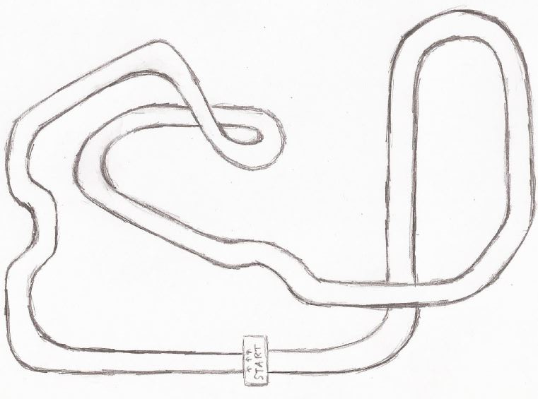
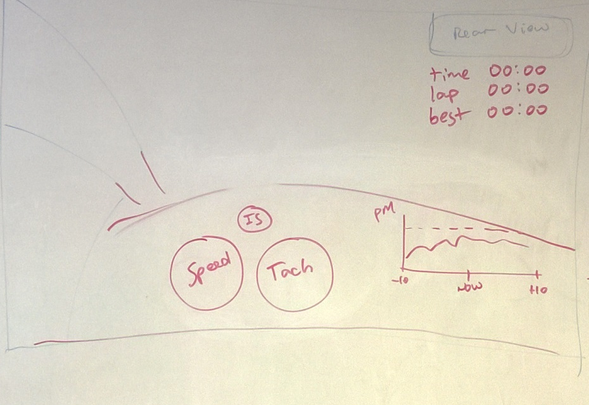
Progress to date
Meeting with VW was a success
Confirmed software choice
Drafts of Viewport and Track ready to produce

Slide 3
Upcoming Tasks
Obtain a license for Simulink 3D Animation
Work on 3D car/track design
Map Steering-Wheel input (Simulink Joystick input)
Create real-time data visualizations (graphs)
Map track position data to MATLAB-readable dataset

Slide 4
Design Tasks
Car:
Dashboard with speedometer, tachometer, indicator light.
Real-time graphs of car data on screen
Track:
Import wrl model of track to match track data
Fit wrl model with track concept (fast mountain road)

Slide 5
Potential Issues
Software Issues
Unfamiliarity with development environment
Met with the MathWorks specialist teaching assistant recommended by you
Getting Software
Before Tuesday, computer was not running Simulink
We are working with a soon-to-expire trial version of the 3D Animation Software.

Slide 6
Potential Issues
Testing
Since our target audience is very experienced with vehicles, finding a comparable user-base to test our design with may be difficult
Not all the parts needed to test the intervention strategy have been provided
“Faking” intervention strategy for initial user tests
Acquiring legal permission to test with subjects outside of project.

Slide 7
Milestones
Past Milestone: VW Presentation
Future progress is dependent on availability of software
Only hard deadline is a working simulation by the end of the semester, which needs
Track and Dashboard 3D Models
Input to vehicle simulation model
Real-time views updating to show information from the model

Slide 8
Stretch Goals
Force Feedback to Controller
Should be easy to add basic implementation
“Ghost Car” of previous lap
Head-tracking?

